Slide 1
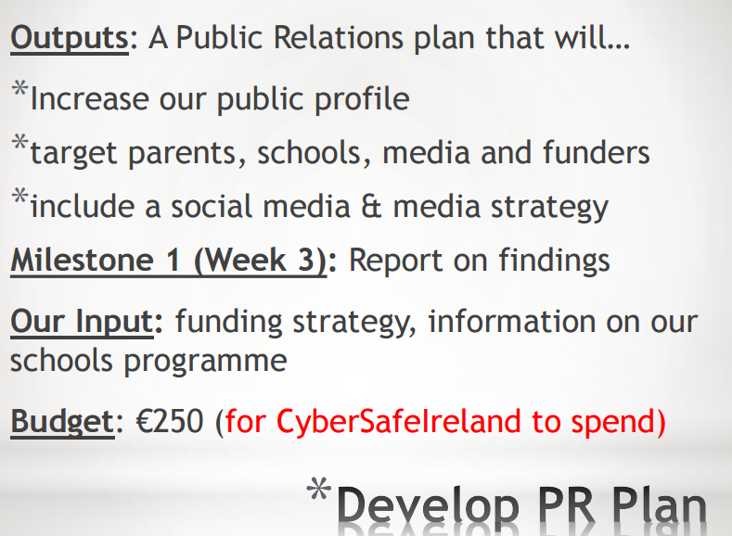
Introduction - Group 4 - PR Plan
Got in contact with WebSummit, The Irish Examiner and RTÉ in regards with talks and articles / shows.
Yet to spend any of our budget and doubt there will be a need to spend much.
Possible investors include tech companies, universities, teaching organisations.
Considered the possible DEIS schools in the Dublin area which could be used for launch.
Researched similar charities in other countries to draw on them for inspiration.
Combed through the possible government organisations and laws that could assist us.

